Slide 1
Assess This!
A Jennilee Fraser Production

Slide 2
Table of Contents
01
06
02
07
03
08
04
09
05
10
KWL Chart, slides 3 & 4
Descriptive Feedback, slides 13 & 14
Web/Concept Map, slides 5 & 6
Pop Quiz, slides 15 & 16
Checklist, slides 7 & 8
Test Crafting, slides 17 & 18
Rating Scale, slides 9 & 10
The Circle of Courage, slides 19 & 20
Rubrics, slides 11 & 12
A Student’s Perspective,, slides 21 & 22

Slide 3
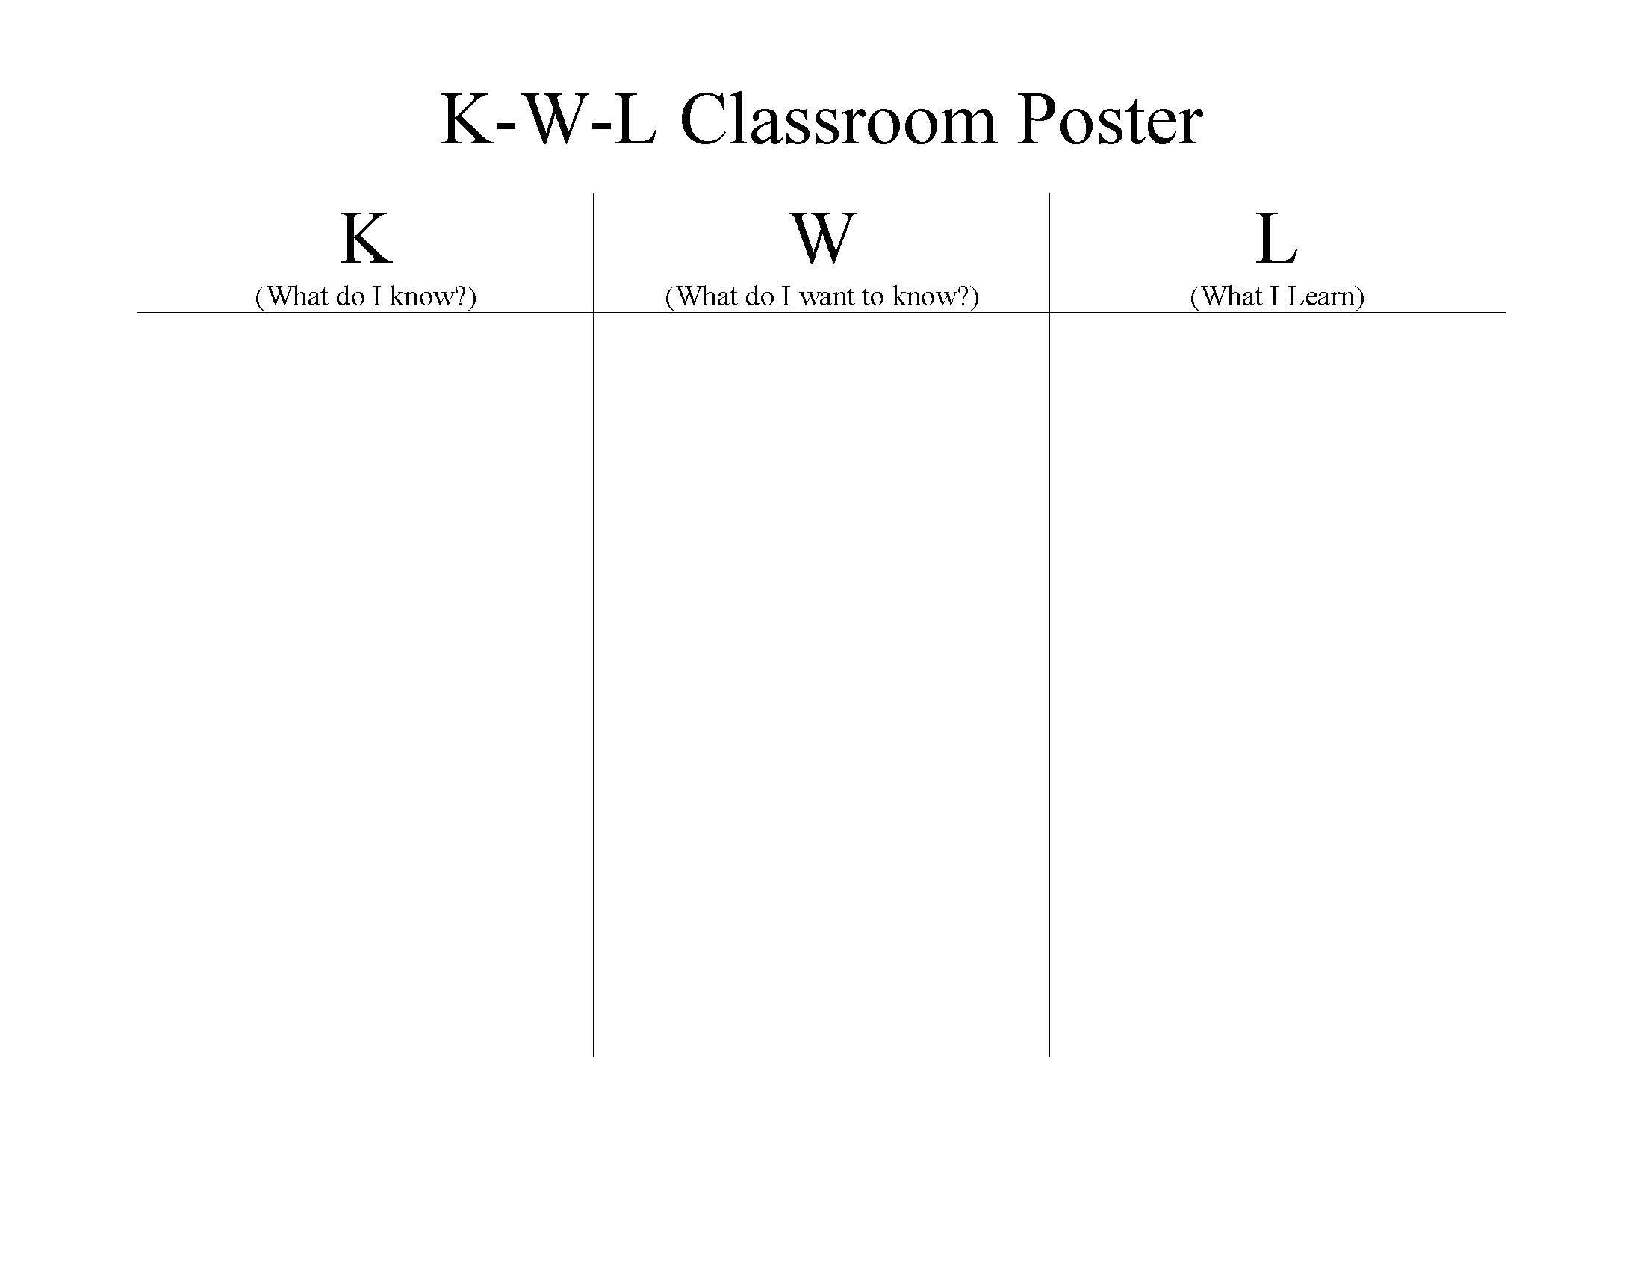
Entry #1 K.W.L Chart
54. K-W-L & KWL: Students respond as whole group, small group, or individually to a topic as to “What they already Know, what they want to learn, what they have learned”.
Assessment FOR Learning
A KWL (Know, Wonder, Learn) chart provides a visual aid for teachers in assessing where students are coming into a lesson and where their learning needs might be, what they are wondering or hoping to learn from about the subject and what the next steps could be in advancing student learning. Students are provided a KWL chart before a lesson, in large groups, small groups or individually, and asked to write down what they already know about the subject, and their wonders/curiosities. Students can read out loud, or hand them in first so the teacher can read them, giving a good indication on where students are at. At the end of the lesson, students will finish the last section “what I learned”, either collectively in a class poster, or by writing a small paragraph, guiding teachers understanding of their learning progress.
.

Slide 4
Reflection
1: FOR Learning
The purpose of this assessment is to help me determine what students prior knowledge is coming into a lesson and where their learning needs might be. Also, by determining what students want to know or are hoping to learn about the subject I can integrate that information, engaging them and advancing their learning. Finally, by having students tell me what they learned within the lesson, I can determine if they have reached the curriculum expectations for that unit, or if I need to spend more time on certain areas.
This is a formative assessment because it provides me with information on student’s learning by offering feedback that I can use to alter lessons and further support students in their learning. It can help me identify which concepts students may be struggling with, and where they already have an abundance of knowledge, which can direct future lessons for optimum learning.

Slide 5
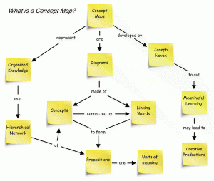
Entry #2 Web/Concept Map
5. Web or Concept Map: Any of several forms of graphical organizers which allow learners to perceive relationships between concepts through diagramming key words representing those concepts.
Concept Circle: Ask students to quickly sketch a concept circle like this image (noting that any number of spikes can be drawn). Students then do an “individual brainstorm”, trying to recall the key concepts that are related to the work they are doing now. Students then highlight or draw a box around, any concepts that they are having trouble understanding. These concepts are then recorded by the student in their learning logs for further examination or they can be discussed with the teacher next time there is an opportunity to do so.
Assessment AS Learning
A web/concept map is a way for students to visually organize information and knowledge by linking concepts together, making meaningful connections between the main topic and other information. Students will identify a question/main point and identify other major concepts using circles, post its, make squares, use capitals or bold fonts etc. Students can use lines or arrows on the map to represent how ideas are connected to one another, a particular category, and/or the main concept. As an added bonus, concept webs can be used in conjunction with other assessment tools (KWL charts, writing frames, 3,2,1 etc).
.

Slide 6
Reflection
2: AS Learning
The purpose of this assessment is for students to monitor their understanding of key concepts and their relationship to each other. Students create a visual of their own learning connections and can reflect on how they progressed from one concept to the next. I like concept webs because it helps to organize information in a tangible way, so you can see the progression of connections being made to seemingly unrelated concepts and better understand student’s thinking. I feel like it helps guide students to answer the question “why is this important” or “why do you have to learn this” using their own prior knowledge. Students are eliciting their metacognitive processes in making those connections, and creating more meaning. It also gives students an opportunity to challenge their thinking, or adjust if the connections to concepts are vague or unobvious.
Also, this formative assessment helps me monitor how students are learning, and how they make connections between information. This way, I can better understand how certain students are taking in information, and better understand how they learn so students can make stronger connections in every lesson.

Slide 7
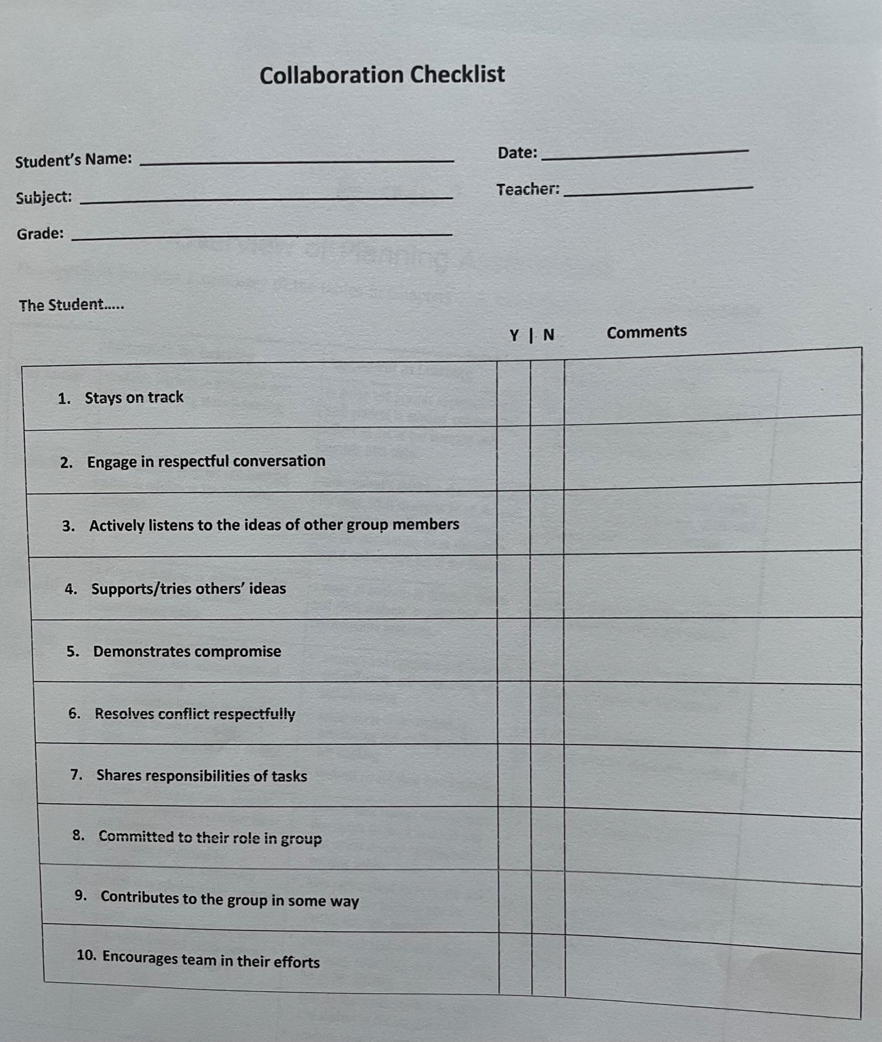
Entry #3…
The Checklist
Checklists are easy to use, flexible forms of assessment that help identify certain skills/knowledge/behaviours using 2, but no more than 3 response columns (yes/no/maybe, happy face/neutral face/sad face, red/yellow/green etc). They require little training and are flexible in their ability to be used with other forms of assessment. Some drawbacks are they can be time consuming to create effectively, can be overwhelming when used for every student on multiple occasions, attitudes towards checklists as valid forms of assessment, and they may not indicate how or how well a student is performing.
An efficient checklist should be organized, concise, fit to one page, include student name, date, grade, subject and have a comment section.

Slide 8
Reflection
3. The Checklist
The creation of the checklist was simple enough, as we combed through the Collaboration Core Competency and highlighted passages we felt were important in examining good collaboration skills. The first thing I noticed when we completed 10 statements were some of them were very technical statements that are challenging to monitor, for instance, “shows awareness about the value of joined effort”. This statement is hard to monitor, though it is important in collaboration, so I would make sure to really address the “how”. In the checklist I created, I simplified it to “supports/tries others’ ideas”, which is easier to observe. I also found that when we were actually using the checklist, students would demonstrate the criteria, and then would do the opposite, and then go back to demonstrating the criteria, so the answer is neither yes or no. Using a maybe column, or the comment section would help here, but it’s still not a full picture as things are rarely black and white. I also found it really difficult to hear over the voices of everyone in the room, so it was hard to identify whether students were resolving conflict, supporting their ideas etc. I had to rely on what I was seeing, rather than what was being said, so I think making a checklist for group work should involve statements that you can see happening, rather than hear. Also, I was given the group that was instructed to “act out” and I didn’t know what I was allowed to do as far as intervening or just observing. I found it hard to make a decision on what to do, so I just did nothing which is not going to get me very far in a real classroom. I do think this is a good way to monitor the core competencies as long as it’s in tandem with other forms of assessment and based on what we can visually observe, especially in group settings.

Slide 9
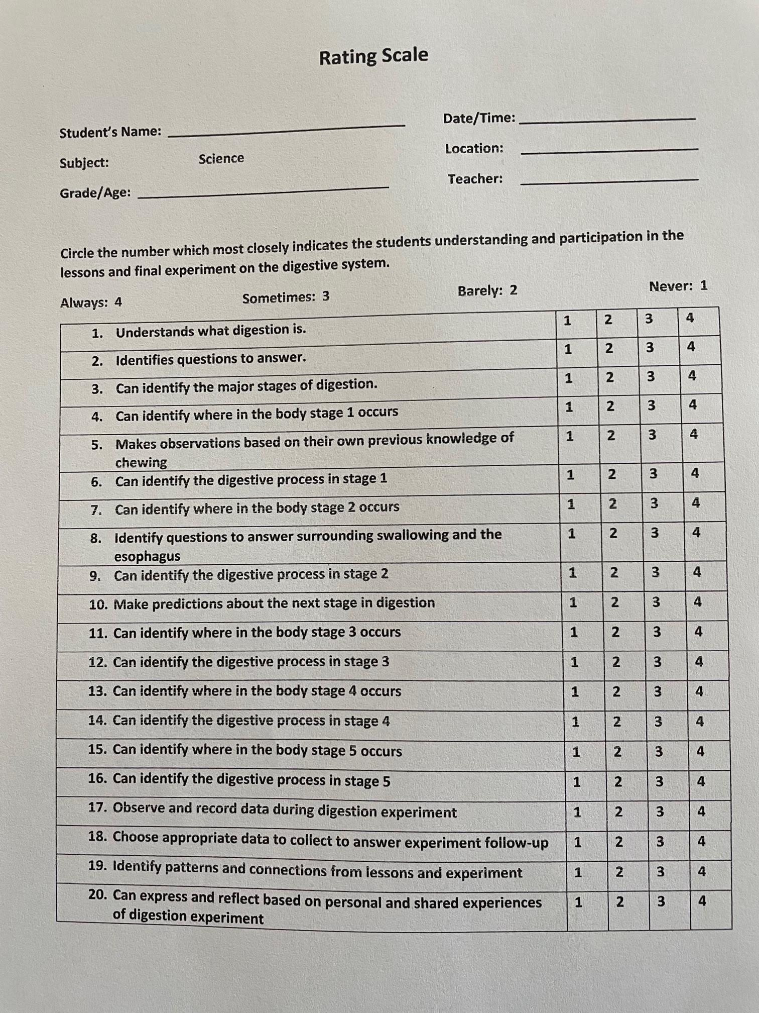
Entry #4
The Rating Scale
Much like checklists, rating scales are simple, flexible and easy to use forms of assessment that are more developed and allows the observer to assess how well a student demonstrates knowledge/skill/behaviour. They help describe a students steps towards understanding using qualitative judgement about the extent to which they are progressing. Some drawbacks are they can be highly subjective, ambiguous, or abstract in their descriptors.
Creating a rating scale is much like a checklist only there are levels of success (1-4 or 5 using numbers, descriptors, emojis, colours etc). Descriptors should be clear and concise in their meaning, while formatting should be detailed, organized, and easy to read.

Slide 10
Reflection
4. The Rating Scale
I created this rating scale for a grade 4/5 unit on digestion, which I am hoping to teach during my practicum in April. I found it a little challenging coming up with the items that I was trying to assess. When I looked at the examples given, they weren’t really on a specific subject, so I just took a combination of subject material (basic stages of digestion) and had the questions surround whether students were able to identify where each stage was and what was involved in that stage. I didn’t go into a lot of detail in the questions, because I wanted to keep it simple and straightforward, I don’t expect students will know or need to know really in depth specifics on these stages just yet as this is the first time they are introduced to it (according to the curriculum). I also used pieces of the curricular competencies to expand on the rating scale to assess deeper learning other than just labelling and memorization. I feel like this could be a good tool to use for a summative assessment, especially the way I’ve laid this one out, though I’m not sure if I’ve done it correctly, because it summarizes some of the important pieces of the unit and gives a rating on how well the students understand the material. It reminds me a lot of the new grading system (emerging, developing, proficient, extending).

Slide 11
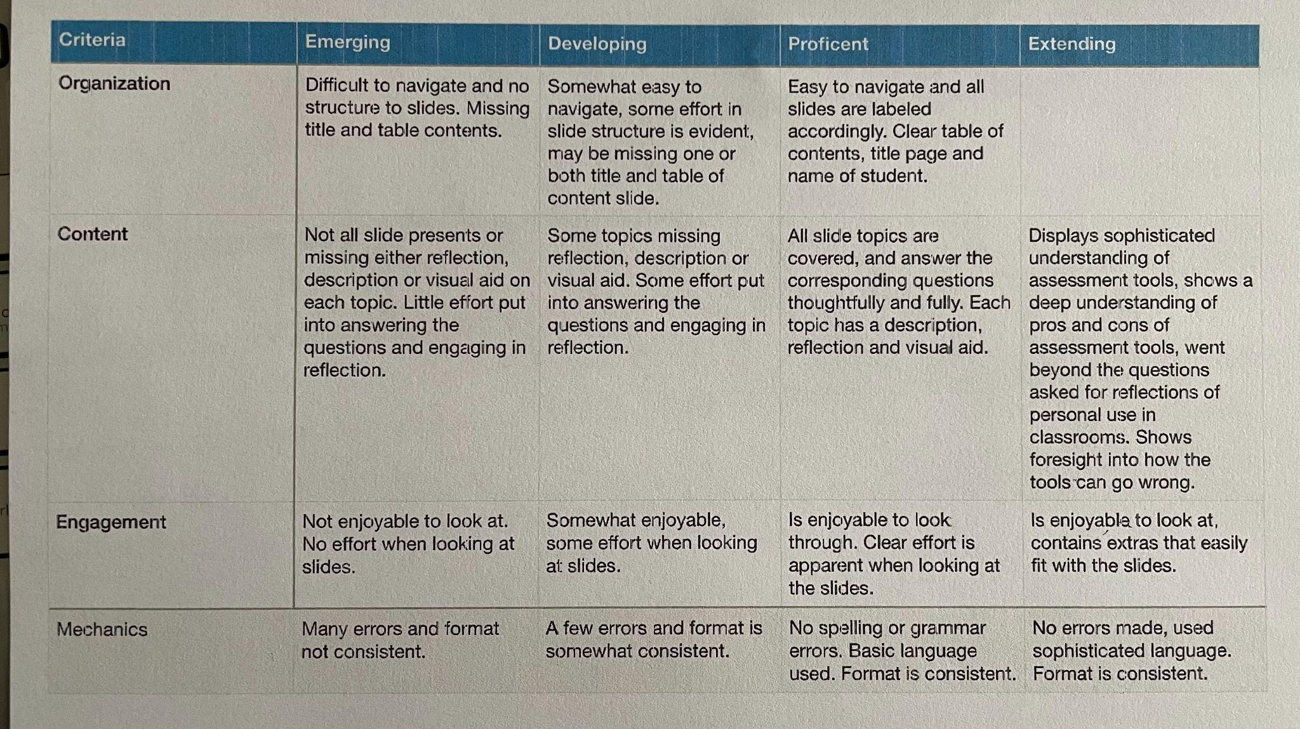
Entry #5
The Rubric
A rubric is a grading tool that details performance expectations for assignments or projects. Criteria is listed in the far left hand column, while the proceeding left hand columns outline the degrees in which an assignment is assessed, ranging from lowest expectations to mastery. Such assessment can be used as learning, as it gives students the opportunity to monitor their own progress along the way and adjust as needed. This can be a good assessment for learning where student’s performance can be regularly assessed between benchmarks and can adjust instruction accordingly. Rubrics can be used as assessment of learning as teachers can use the criteria as a means of assessing student learning and make judgements based on their achievement outlined within the rubric.

Slide 12
Reflection
5. The Rubric
Our creation of the rubric went ok, though I did find some of it a bit challenging. The first thing we did was start at Proficient, because we thought it would be simpler to outline exactly what we would be looking for, the challenging part was then decided on what was extending. When you reach all the criteria that you are looking for then what more are you looking for? We used language like “sophisticated” and “went beyond expectations”, but those are very subjective terms and what one student considers “sophisticate” may not be what I, as the teacher, feel is sophisticated. We had such a hard time with the extending section that we didn’t finish “extending in organization”. The other challenge was wording the “emerging” category in a way that would that wouldn’t negatively impact the student’s self esteem. It’s hard to outline the bare minimum in a straightforward way that doesn’t sound negative, in fact we still ended up using language like “not enjoyable” and “little effort put into…” just out of habit from what we’ve seen from other rubrics. I think the next time I create a rubric I’m going to need to spend a lot of time being aware of the language I’m using and make sure that “emerging” is a category that describes a beginning understanding rather than a “just not trying at all” category.

Slide 13
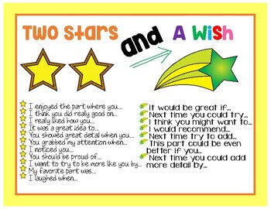
Entry #6 Descriptive Feedback
Star!!!!!!!!
Star!!!!!!!!
I really liked how indigenously inspired the unit plan was. You could tell that you took a lot of time to really reflect on what that meant to you and how you could implement that into every lesson. You could tell that it was really important to you, and that resonated throughout the whole unit. Well done!
I was really impressed to see so much cross-curricular education that you were able to navigate within your unit. You have Language Arts, Social Studies, Science, PHE, and Visual Arts, all managing to link together with creating a sense of community and safety.
Wish!!!!!
I would recommend spending a little more time developing a variety of assessment pieces. We know how important assessment is to help students on their learning journey, and having a variety of different ways to assess learning is going to help you and your students along away.

Slide 14
Reflection
6. Descriptive Feedback
Creating the feedback for my Two Stars and a Wish descriptive feedback was relatively easy because I had already considered some of these things when I was creating the unit plan. I was really pleased with the time and energy I invested in making it indigenously inspired, and the effort that went into making it as cross-curricular as I could. Because I knew the amount of effort I put in, I had a good sense of what the “Stars” would be. The “Wish” portion I took out of your feedback, though I was already feeling like that was a place where I had the least amount of expertise and could use some polishing. I think if you are really connected to your students, and you understand what hard work looks like for them, it won’t be difficult to come up with positive feedback that resonates with their learning, which will have the most impact for them moving forward. As was with the rubric, making sure the language you use in the “Wish” section is going to matter a lot in how they take it. I could also see students disregarding the “Wish” section all together and just focusing on the positive feedback they got. I was thinking that having a few classes practicing constructive criticism might not be a bad strategy before using this or a rubric. This would be a good strategy to use on big projects, or a unit where students have been struggling. If you started on day one with descriptive feedback, then at the end of the unit have them do the same task and show them how far they’ve come could be really impactful.

Slide 15
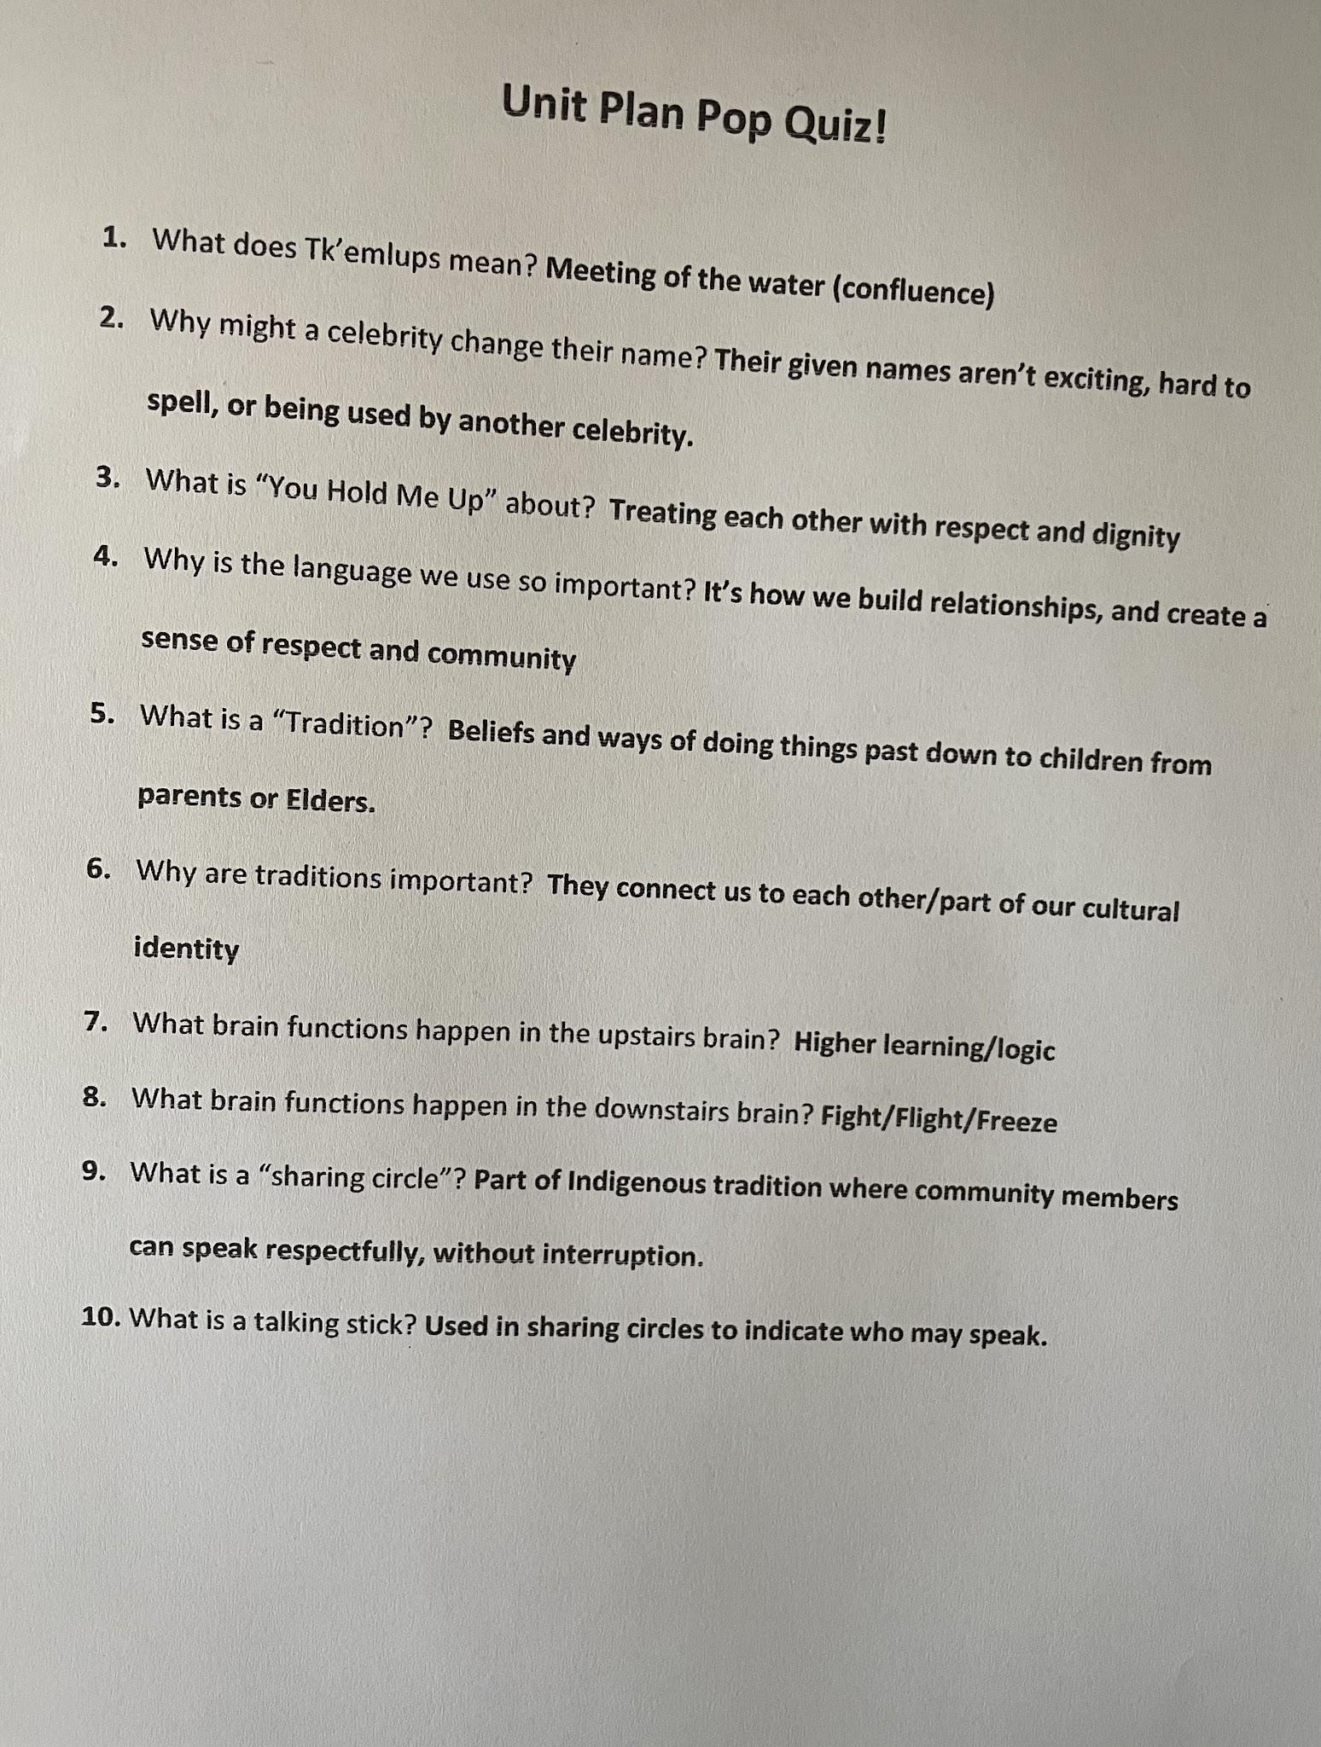
Entry #7 The Pop Quiz!
Why Use a Pop Quiz?
A pop quiz is an excellent way to activate schema before a lesson or unit to have students engage in any previous knowledge they may have about a subject. Pop quizzes are a good tool as an assessment for learning either before or after a subject as it gives students (and teachers) an indication of what they have learned, and what they need to spend more time on.
How to launch a Pop Quiz
I believe pop quizzes can be a fun and engaging way for students to see what they already know or what they have learned about a specific topic, but can only work effectively if the anxiety of test taking has been removed from the equation. Pop quizzes should be introduced as a learning tool and not fur marks or grades. They can be approached in a variety of ways (kahoot quizzes, a jeopardy game etc) to keep students engaged and relaxed, with multiple ways of answering (verbal, illustrations, or written).

Slide 16
Reflection
7. The Pop Quiz
Because I had made my Unit Plan fairly detailed, it wasn’t too difficult to create the pop quiz. I really like the concept of using a pop quiz as a way to alleviate test anxiety for students by using them often, and not for marks. The more practice students get taking tests in an atmosphere that is fun, informative and engaging, without the looming label of a grade that goes along with it, the more we are able to form different neural pathways around testing. Testing can be a great summative assessment tool, but only if students aren’t engaged in a fight/flight response while taking them.
Using quizzes as a formative tool as learning or for learning is also a really beneficial practice, providing we take the anxiety out of the equation. It gives students a good idea of what they’ve learned so far and what information still needs to be learned and understood, and it gives the teacher a look at what lessons really stuck for students, and what lessons need to be revisited. Of course, all students are different and will absorb information differently, but the more feedback you have when it comes to lessons, the more you can adapt and add to your tool box.

Slide 17
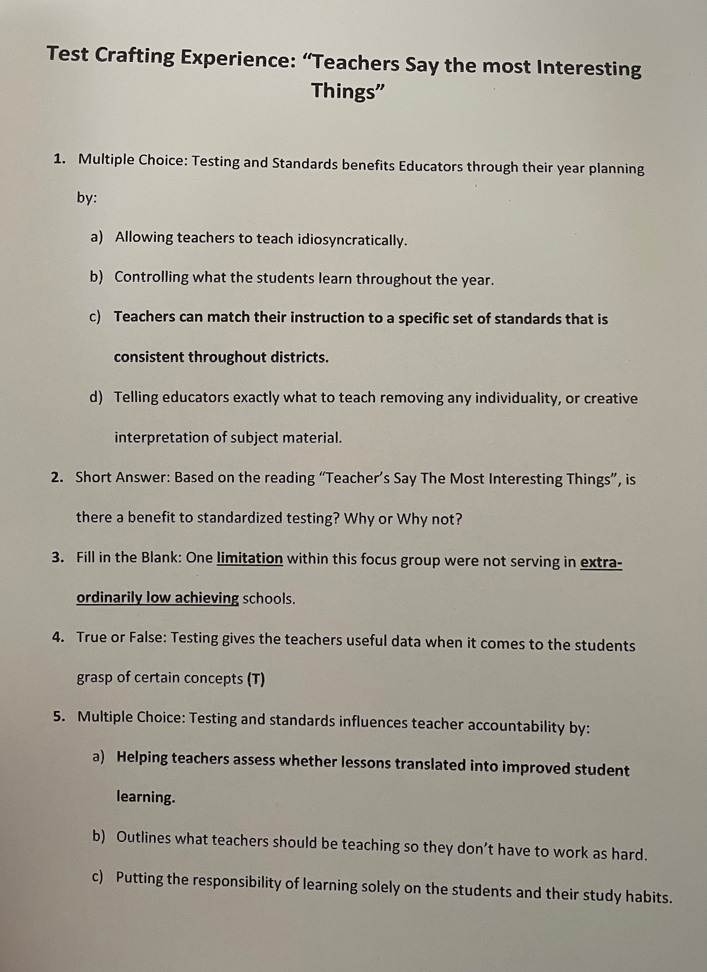
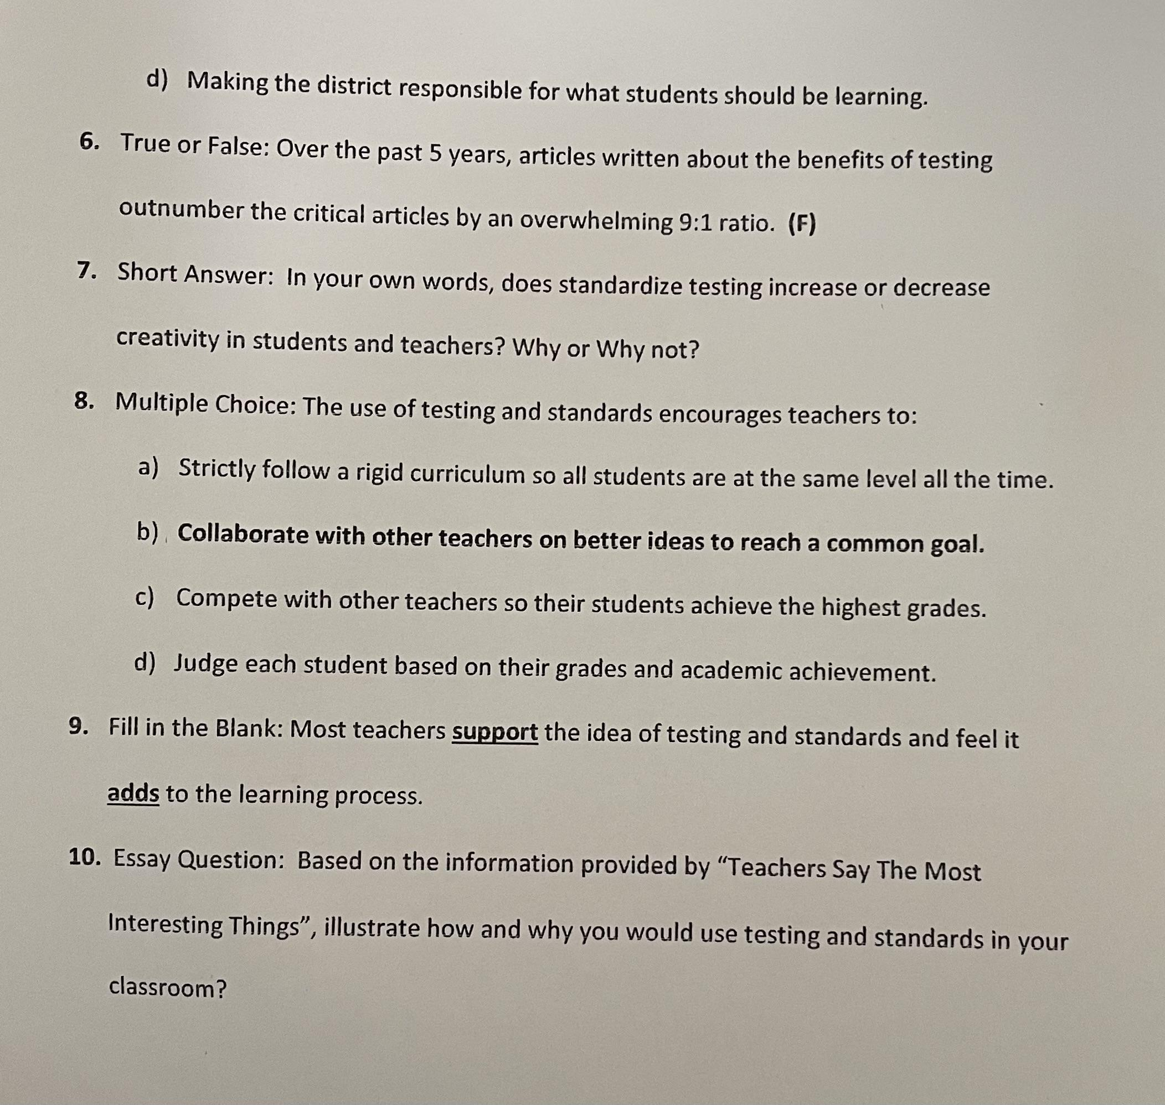
Entry #8 Test Crafting
Standardized Testing!
Provides useful data (sum)
Roadmap for year instruction
Teacher/student creativity
Teacher collaboration
Accountability of learning for teacher and student

Slide 18
Reflection
8. Test Crafting
I found the multiple choice questions the hardest to craft. It was difficult coming up with the answers that were not the correct one, and making it sound as though it weren’t obviously wrong. I’ve never been a big fan of multiple choice questions because I always felt like they were trying to trick me, but I can see why crafting a good multiple choice question can be like that. You don’t want to make the answers obvious, but how do you do that in a way that isn’t devious? I think if I spent a lot more time on it I could figure it out, but I definitely have a new perspective on it. I found the essay and short answer questions were the easier ones. I’ve always preferred those kind of questions because they were more about how I perceived the information, rather than rote memorization which I struggle with. Reflecting and interpreting have always come more naturally to me.
Suggestions I would make to anyone creating a test for the first time (or even myself for next time) is to make sure to spend a good deal of time on it, and be really clear on what information you wanted students to take out of the material you’re testing. It’s important to be really specific on what learning you want to assess when creating a test, so you’re not just pulling out random snippets from the unit. This is where learning intentions are really important. What is it that you wanted students to learn here and why is that important.

Slide 19
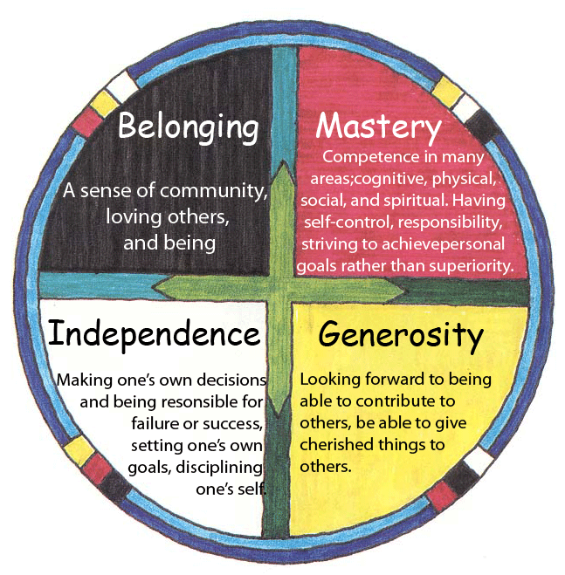
Entry #9
The Circle of Courage
“The Circle of Courage® is a model of positive youth development based on the universal principle that to be emotionally healthy all youth need a sense of belonging, mastery, independence and generosity. This unique model integrates the cultural wisdom of tribal peoples, the practice wisdom of professional pioneers with troubled youth, and findings of modern youth development research. Recognizing that the Circle of Courage “transcend[s] cultural boundaries” and that “all children have the same growth needs” the Circle of Courage is an offering for all youth across cultures and contexts.”*
Circle of courage®. Starr Commonwealth. (2021, October 14). Retrieved March 31, 2022, from https://starr.org/circle-of-courage/
This indigenous framework resonates so much with me because I believe when students feel valued, significant, safe and supported by the teacher and their peers, they become more open to learning and community engagement. This connects deeply with assessment because when students feel safe and valued, they can use assessment as a way to drive their learning forward, learning from their mistakes and making meaningful connections, rather than a criticism of who they are.

Slide 20
Reflection
9. The Circle of Courage
My connection with The Circle of Courage intersects with indigenous worldviews and assessment because without positive foundations for psychological development, resilience and positive youth development, the purpose of assessment loses its meaning. When students don’t feel like they belong, they don’t feel safe. When students don’t feel safe they aren’t able to connect with deeper learning, which is an important stepping stone to mastery. Mastery, the next phase in the Circle of Courage, is where students gain resilience and confidence in their own abilities, allowing them to gain independence and gain inner discipline and personal responsibility, which is the next phase in the Circle. With self awareness comes reflection, opening ourselves up to generosity, community engagement and selflessness. This resonates with my understanding of assessment because I believe assessment is the road map for learning, whether in school or life in general. If you don’t feel safe, you can’t assess situations with clarity. You can’t accept assessment as a means to guide you through learning, you’re too busy trying to survive. If you aren’t confident in yourself and your own abilities, assessment becomes a criticism and causes anxiety and sadness. If you aren’t confident, you struggle with being independent with your learning, and assessment either gets ignored or, again, becomes to reasons you’re not “smart”. If you feel stupid, you’re not going to feel like you have anything to offer your community, and your higher learning becomes more about survival, and assessment losses its purpose. The two concepts go hand in hand to promote growth and learning for everyone.
Notes:
Entry #10: Interview Willow and Kadance about how they feel about assessment.

Slide 21

Entry #10: Extending, a Student’s Perspective
I asked a grade 9 student “What does it mean to be extending?”
“From what my teachers have told me, it’s doing more than what is required. So like, in a slide show, if you need 7 slides, find extra information and go above and beyond what is expected of you.”
“Being as you have had both the Proficiency scale and Letter grades,which one motivates you to do better on assignments?
“The percentages that go along with letter grades are more motivating than just “Exceeding” on the proficiency scale because it’s more accurate, and gives you more areas you can fall into, rather than just four categories. The proficiency scale focuses on trying to produce less pressure but its not helping. It’s just showing you where you are meeting rather than saying you have a C+ you can do these few things to move up to a B. The proficiency scale puts you in a spot that you’re not easily able to move out of, what you get is where you stay because there aren’t clear guidelines for how to improve, just fancy words that don’t make a lot of sense.

Slide 22
Reflection
10. A Student's Perspective
I decided to interview my 14 years old step daughter to get her perspective on what she thought about what it means to be extending. I also chose her because she has had both the traditional letter grade system and the proficiency scale, so I thought her opinion would be a good perspective. I was surprised at her answers, as I was expecting her to prefer the wider range of possibilities within the proficiency scale. She was quite passionate about her distaste for it, as she feels that there was no way to change your rating out of Proficient. I had suggested to her that the proficiency scale was supposed to be about monitoring your learning progress in a way that was less about grading and more about assessing development. She said that may be what they want it to be, but it’s just less boxes to put you in, which doesn’t make you want to do better, it actually makes you feel like “it’s good enough” so you don’t try harder. It’s just fancier words for grades. Even during self assessment, sometimes you weren’t given the option for extending, even when you felt like you did your best work ever. So how do you extend if there’s no extending?
I think what’s happening is that we’re in a transition period where we know, as educators, where we want to go as far as assessment of learning but it’s going to take time for people to unlearn the system that has been in place for nearly 100 years. I’m stuck in this position myself, where I think as soon as you start to measure effort and learning in terms of grades or degrees, there is going to be pressure in one direction or another. On the other hand, I can’t imagine what a school would look like if there was only learning and no assessments or grades at all. In a perfect world that might be a better scenario, but then what’s the motivation? I often think of extending as being so well versed in the subject that your passionate to teach it. In martial arts, once you reach a certain proficiency, you are required to teach the novices. In fact, you need a certain amount of teaching to reach the higher belt levels. Maybe that’s what it means to “extend”, using your knowledge base to propagate the knowledge itself? If this is the case, then my own “extending” in this course would be how I’m able to teach assessment to others. If this is the case, I need way more practice.

Slide 23
Thank you!
Do you have any questions?
Fraserjonesj11@tru.ca
250-572-2498

